Slide 1
Header:
Welcome to Benri!
At Benri, we offer a lot of exciting experiences, such as “Text Extraction from Images”, “Image Processing”, “AI-Powered Image Creation” and more. My website is constantly evolving and improving to ensure you have the best possible experience. Your support means the world to us as we strive to deliver excellence. Thank you for joining us on this journey!

Slide 2
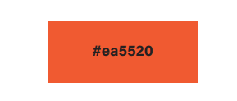
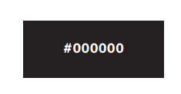
Có 2 màu sắc chính là màu Đen & Cam
Màu sắc:
#ea5520
#000000

Slide 3
Header:
LOGO
HOME
About me
My works
Blog
Contact
Welcome to Benri!
At Benri, we offer a lot of exciting experiences, such as “Text Extraction from Images”, “Image Processing”, “AI-Powered Image Creation” and more. My website is constantly evolving and improving to ensure you have the best possible experience. Your support means the world to us as we strive to deliver excellence. Thank you for joining us on this journey!

Slide 4
Header:

Slide 5
Header:

